Slide 2
Catholic Ladies’ College
Monday 5 August

Slide 3
Welcome , Acknowledgement of Country
Introductions
Purpose and Aims
Reflection

Slide 4
Mission and Values: how they inform and influence culture… Aims and Purpose:
Grow in knowledge of Mary Aikenhead and the Sisters of Charity
Grow in understanding of Mary Aikenhead Ministries
Exploration of mission and culture
Recognition of the contributions and work of non-teaching staff at CLC
Recognise our place in this evolving story

Slide 5
A Song of Strength…
What did you hear?
What did you feel?
How were you touched?

Slide 6
Mission… How do you/we understand Mission?
Mission….Vision and Purpose
“I have come that you may have life and have it to the full.”
John 10:10
The Mission of Mary Aikenhead Ministries ( from Formation Policy)
MAM continues the mission of God to love through the healing, teaching, and pastoral ministries of Jesus Christ. Inspired by the spirit of Mary Aikenhead, through an energetic stewardship, we respond to the needs of the times in innovative ways, especially for the poor, marginalised and vulnerable.

Slide 7
Organizational Culture: What is it? How is it understood and experienced? Why?
“Culture is how we ‘do things’ things around here.”
“Organisational culture defines a jointly shared description of an organisation from within.”
“Culture is a process of sense-making in an organisation.”
“Organisational culture is the sum of values and rituals which serve as ‘glue’ to integrate the members of the organisation.”
“ Organisational culture is civilisation in the workplace.”
“ Culture is the organisation’s immune system.”
“ It oversimplifies the situation in large organisations to assume there is only one culture…its risky for new leaders to ignore the sub-cultures”

Slide 9
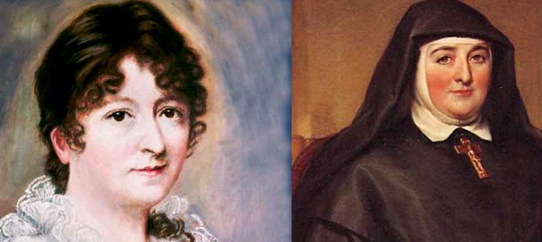

Slide 10
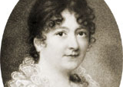
Who was Mary Aikenhead, what is her story?
What do we know of the world and times that Mary lived in?
Mary Aikenhead

Slide 11
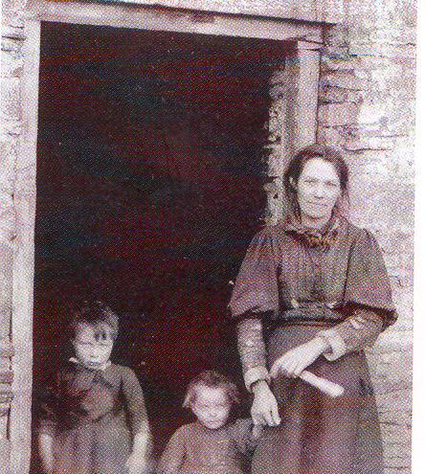
Mary Aikenhead: her life and beginnings…
Born, Cork, Ireland: 19 January 1787. April, baptized into the Anglican Faith. Father Dr David Aikenhead, Scots Protestant, mother, Mary Stacpole, Catholic, siblings: Anne, Margaret and St John.
1787-1793: catholic foster family, Eason’s Hill Cork. John and Mary Rorke
1793: aged 6, Mary returns to live at her parent’s house.
1801: David Aikenhead dies, becomes a catholic on his death bed.
1802: Mary, aged 15 years becomes a catholic
1809: Mary, aged 22 years meets Archbishop of Dublin, Daniel Murray. August, her mother dies and Mary become the head of the family.

Slide 12
Mary Aikenhead: her life and beginnings…
1810: Mary, together with her friend, Mrs Anna O’Brien and with the encouragement of Dr Murray, begins to explore the idea of a new religious order to visit the poor.
1811: Mary, aged 24 year, undertakes her novitiate at the Mickelgate Bar Convent, York. She is chosen as superior of the new order.
1815: Mary takes temporary vows and opens the first convent in Dublin. The Sisters of Charity become known as the ‘walking sisters.
1819- 1830: Several convents opened throughout Ireland. Dublin, Cork, Galway and surrounding country. areas. The

Slide 13
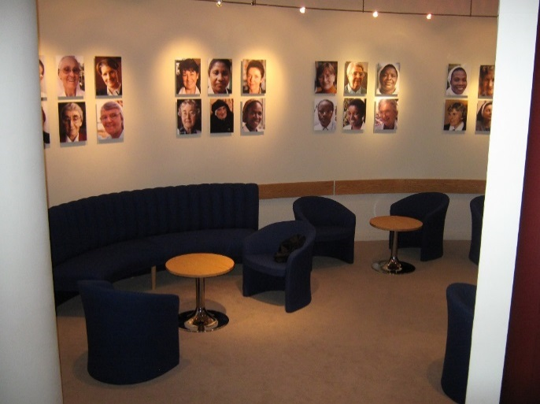
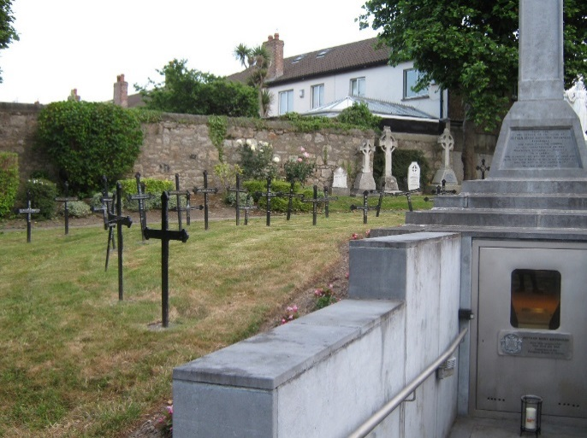
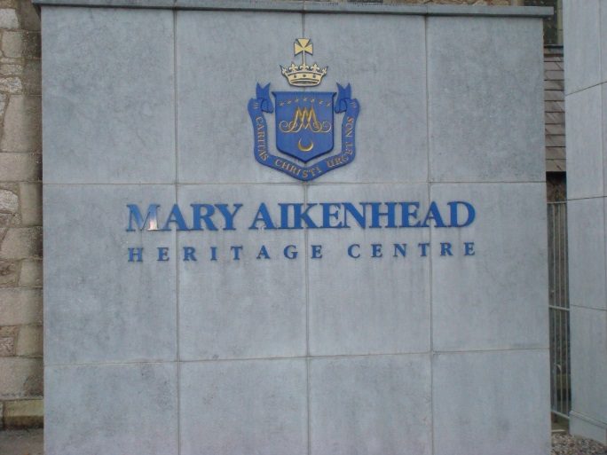
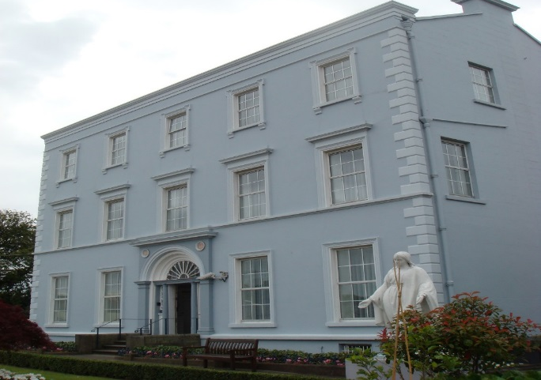
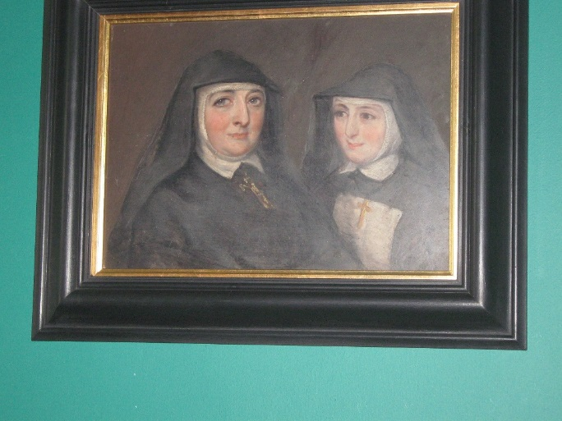

Slide 15
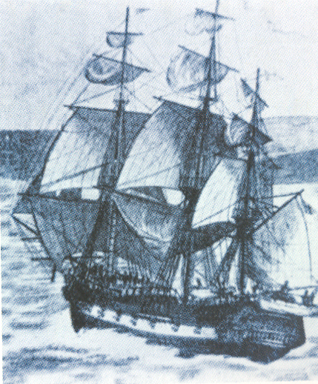
Sisters of Charity, their story and spirituality and Charism
The beginnings…
Motto: “Caritas Christi Urget Nos”
Spirituality
Prophetic in outlook
Trust in Divine Providence
Practical and forward thinking

Slide 16
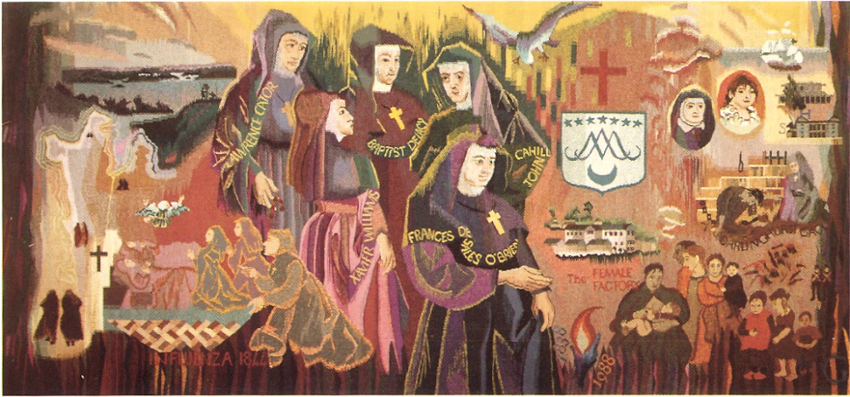
The Australian Sisters of Charity Standing on the shoulders of those who have come before us……
Arrival 1838
Early Ministries in Sydney and then Hobart
The growth and diversification of their ministries
Their traits, their tenacity, their legacy……

Slide 17
Mary Aikenhead Ministries: the Journey continues….
Public Juridic Person, established 2009: What and Why?
“ Our Congregation’s spirit and our inheritance is the gospel privilege of serving others, especially the poor. Our story is one of innovation, courage and conviction. It is our hope that this will continue. We are confident that through Mary Aikenhead Ministries, the spirit of service will flourish in new and progressive ways, always alive to the spirit of the times.”
Sr Elizabeth Dodds rsc, Congregational Leader at the time of MAM establishment.
MAM Values: Love, Hope, Justice and Compassion

Slide 18
Establishment of Mary Aikenhead Ministries
‘Through our trust in Divine Providence, our vision is to witness the Gospel through our commitment to the values of hope, justice and compassion in loving service of God’s people, especially the poor and marginalised.’
‘The Trustees will ensure that the heritage, tradition and charism of the Sisters of Charity are taken purposefully into the future.’

Slide 19
Our place in the story….
“And no-one sews a patch of unshrunk cloth to an old coat; for then the patch tears away from the coat, and leaves a bigger hole. Neither do you put new wine into old wine-skins; if you do, the skins burst, and then the wine runs out and the skins are spoilt.” Mark 2:22
In the spirit of renewal and responding to the needs of the Church in the 21st century, the Sisters of Charity look towards the future with joy and hope. In considering a new sponsorship model, we have focused on the ministries, with respect for and celebration of the rich heritage of the works originally undertaken and developed by the Sisters of Charity. We trust that the newly chosen sponsorship model will further these ministries.
Extract from the Theological Statement
Notes:
As you read this, what does it mean/say to you ion your particular ministry? What do you think the Sisters chose this scripture as part of the application for the PJP?

Slide 20
Establishment of Mary Aikenhead Ministries

Slide 21
By this everyone will know….
Enduring Story: Jesus, and his life, ministry and the values of the Gospel: Potential to consider scripture, reflect on the key messages of the life of Jesus as it speaks to you in your ministry today.
Expressive Story, how this story and these values are given expression in the prophetic response of Venerable Mary Aikenhead and the Sisters of Charity through their charism, ministry and tradition: potential to share, reflect upon values of Mary Aikenhead and the Sisters of Charity that are evidenced in your ministry today?
Evolving Story, how we work with these legacies in an interpretive manner that carries our faith, spirituality and tradition purposefully forward to meet the challenges revealed in the signs of the times: potential to consider the emerging story of your ministry, in the context of current stewardship, future opportunities, being a prophetic people.

Slide 22
By this everyone will know……MAEA contemporary indicators
The love of Christ impels us | A source of witness A call to action Experiencing the love of Christ in all structures, processes, programs, relationships and actions
Preferential option for the poor Social action and justice | Preferential option for the poor and vulnerable Rigorous and vigorous advocacy for justice Promoting opportunities for hope
Trust in Divine Providence A spirituality of possibility | Deep personal faith and a spirituality of action The immanence of God in our mission The presence of the Divine in each and all
Contemplatives in action Learning and teaching | Ignatian reflection and discernment Relationship between individual God and the world Contemplation and discernment leading to transformation
Called to be extensively useful Achievement and excellence | Educational outcomes that deliver high achievement Responsibility to contribute to the common good Commitment to service and social and cultural innovation for justice
Going to the margins Forward thinking and innovation | Cultures of restlessness Moving to need Creativity and imagination

Slide 23
The mission of Mary Aikenhead Ministries is central to its task and calls forth a response through its multiple expressions.
From this mission, carried out on behalf of the Church, the Gospel values emerge.
Mary Aikenhead Ministries identify Love, Justice, Compassion and Hope as central to their expression and witness of the Gospel.

Slide 24
Mission… How do you/we understand Mission at CLC?
Where do we find Mission?
What does it look like in..
Learning and Teaching
Student Wellbeing
Teacher/Leadership development
Faith and Liturgy
Service provision to the community
Relationships
Finance, Facilities and Resources
Preferential Option for the Poor
Social Justice and Community Outreach
Value of every person to and within the organisation.

Slide 25
Mary Aikenhead Ministries and Catholic Ladies’ College…. My place in the story…
What have I learnt today…
Among the things that I have heard, the thing that moved me most was…
Among the things that I have heard, the thing that challenged me most was…
How am I called in my work…
The one thing that may change about the way I do my work…

Slide 26
Going Forward….
“ We cannot live in the past, each age has its own challenges, we cannot continue to do things the ways that they were done; the true gifts for us are the opportunities as presented in the current time frame. It is amazing to think that the first five Sisters of Charity came to Australia with practically nothing, trusting in the providence and will of God.
The whole of the Catholic society has changed, past life revolved around Church, School and Parish.
Today we are touched by and open to many other influences, educate for now and the future – go forth as apostles of Christ, responding to the times.”
Sr Moira O’Sullivan rsc, April 2012

