Slide 2
Mission and Values: how they inform and influence culture
24 January 2019

Slide 3
Mission and Values: how they inform and influence culture… Aims and Purpose:
Grow in knowledge and understanding of Mary Aikenhead Ministries
Alignment of MSM heritage and MAM/MAE Mission, Vision and Values
Exploration of notion of organisational culture
Recognition of the contributions and work of non-teaching staff at MSM
Seek to understand the MAM Ethical Framework and how it relates to our work
To be provided with resources to read/think about.

Slide 4
A Song of Strength…
What did you hear?
What did you feel?
How were you touched?
Notes:
Is there anything in this story that, for you, connects with the community of Mt St Michael’s College?

Slide 5
Organizational Culture: What is it? How is it understood and experienced? Why?
“Culture is how we ‘do things’ things around here.”
“Organisational culture defines a jointly shared description of an organisation from within.”
“Culture is a process of sense-making in an organisation.”
“Organisational culture is the sum of values and rituals which serve as ‘glue’ to integrate the members of the organisation.”
“ Organisational culture is civilisation in the workplace.”
“ Culture is the organisation’s immune system.”
“ It oversimplifies the situation in large organisations to assume there is only one culture…its risky for new leaders to ignore the sub-cultures”

Slide 6
Mission… How do you/we understand Mission?
Mission….Vision and Purpose
“I have come that you may have life and have it to the full.”
John 10:10
The Mission of Mary Aikenhead Ministries ( from Formation Policy)
MAM continues the mission of God to love through the healing, teaching, and pastoral ministries of Jesus Christ. Inspired by the spirit of Mary Aikenhead, through an energetic stewardship, we respond to the needs of the times in innovative ways, especially for the poor, marginalised and vulnerable.

Slide 7
The mission of Mary Aikenhead Ministries is central to its task and calls forth a response through its multiple expressions.
From this mission, carried out on behalf of the Church, the Gospel values emerge.
Mary Aikenhead Ministries identify Love, Justice, Compassion and Hope as central to their expression and witness of the Gospel.

Slide 8
Mission… How do you/we understand Mission at MSM?
Where do we find Mission?
What does it look like in..
Learning and Teaching
Student Wellbeing
Teacher/Leadership development
Faith and Liturgy
Service provision to the community
Relationships
Finance, Facilities and Resources
Preferential Option for the Poor
Social Justice and Community Outreach
Value of every person to and within the organisation.
Notes:
Conversation here

Slide 9
Values gifted to Mary Aikenhead Ministries by Sisters of Charity at time of establishment of PJP
Notes:
Values gifted, Ethical Framework, Theological framework. Today we will consider the Ethical Framework, and how we are part of this as we contribute to and influence the culture of MSM College.

Slide 10
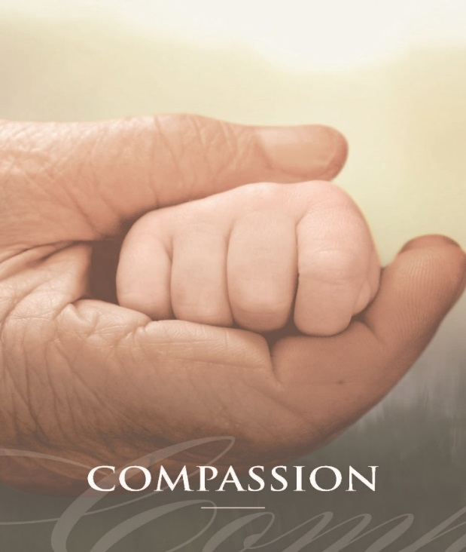
Values gifted to Mary Aikenhead Ministries by Sisters of Charity at time of establishment of PJP

Slide 11
The Ethical Framework is a public statement of what the works of Mary Aikenhead Ministries stand for and what the wider community can expect of these Catholic services.
Ethical Framework for Mary Aikenhead Ministries
Introductory Statement
The permanent principles of the Church's social doctrine ... are: the dignity of the human person, the common good, subsidiarity, and solidarity. These principles, the expression of the whole truth about the human person known by reason and faith, are born of "the encounter of the Gospel message and of its demands summarised in the supreme commandment of love of God and neighbour in justice with the problems emanating from the life of society".
Compendium of the Social Doctrine of the Church, par.160
Notes:
Provide a guide for the behaviour and decision-making of all persons in Mary Aikenhead Ministries
Facilitate a prophetic stance against policies, positions and practices contrary to the vision and values of Mary Aikenhead Ministries
Encourage an organisational culture which expresses the vision and values of Mary Aikenhead Ministries.

Slide 12
The Dignity of the Human Person God has imprinted his own image and likeness on man (cf. Gen 1:26), conferring upon him an incomparable dignity ... In effect, beyond the rights which man acquires by his own work, there exist rights which do not correspond to any work he performs, but which flow from his essential dignity as a person. John Paul II, Centesimus Annus, 1991, #11
Recognises the dignity of each individual human person as inviolable
Brings with it natural rights and duties
Promotes the human rights especially of those who lack services, lack access to services, cannot participate or are refused the opportunity to participate in significant national, state and/or community activities and discussions
Ensures that every person, especially the most disadvantaged and marginalised, has reasonable access to more than just the basic necessities of life.

Slide 13
The Common Good It grows increasingly true that the obligations of justice and love are fulfilled only if each person, contributing to the common good, according to his own abilities and the needs of others, also promotes and assists the public and private institutions dedicated to bettering the conditions of human life. Paul VI Gaudium et Spes, 1965, #30
Actively seeks conditions that enhance the good of all
Requires that the poor, the marginalised and, in all cases, those whose living conditions interfere with their holistic growth should be the focus of particular concern
Ensures a response to injustice at local and global levels and a commitment to working for a more just society and a more humane world
Takes the issue of poverty beyond charitable acts and into the questioning and challenging of social values and structures
Demonstrates responsible stewardship in the quality and professionalism of individual and collective work
Fosters collaboration rather than hierarchical management, ensuring a cohesive engagement of all involved
Contributes to the achievement of a quality common life together
Takes responsibility for caring for the environment.

Slide 14
Subsidiarity Just as it is gravely wrong to take from individuals what they can accomplish by their own initiative and industry and give it to the community, so also it is an injustice and at the same time a grave evil and disturbance of right order to assign to a greater and higher association what lesser and subordinate organisations can do. Pius XI, Quadragesimo Anno, 1931, #79
Enables participation of and among those who make up the organisation
Fosters life within the organisation, without undue social control and unwarranted interference
Ensures participation in decision-making processes affecting personal and organisational life
Promotes decision-making that is empowering of those involved and affected in the process
Ensures that decision-making processes include consultation with those who will be most affected by them.

Slide 15
Solidarity Solidarity is undoubtedly a Christian virtue ... In the light of faith: solidarity seeks to go beyond itself, to take on the specifically Christian dimension of total gratuity, forgiveness and reconciliation. One's neighbour is then not only a human being with his or her own rights and a fundamental equality with everyone else, but becomes the living image of God the Father, redeemed by the blood of Jesus Christ and placed under the permanent action of the Holy Spirit. John Paul II, Solicitudo Rei Socialis, 1987, #40
Acknowledges that our responsibilities to each other cross national, racial, cultural, economic and ideological differences
Respects and promotes personal, social, economic, cultural and political rights
Presents a spiritual and material solidarity with all people, especially those who are marginlised, vulnerable or distressed, giving priority to those in greatest need.

Slide 16
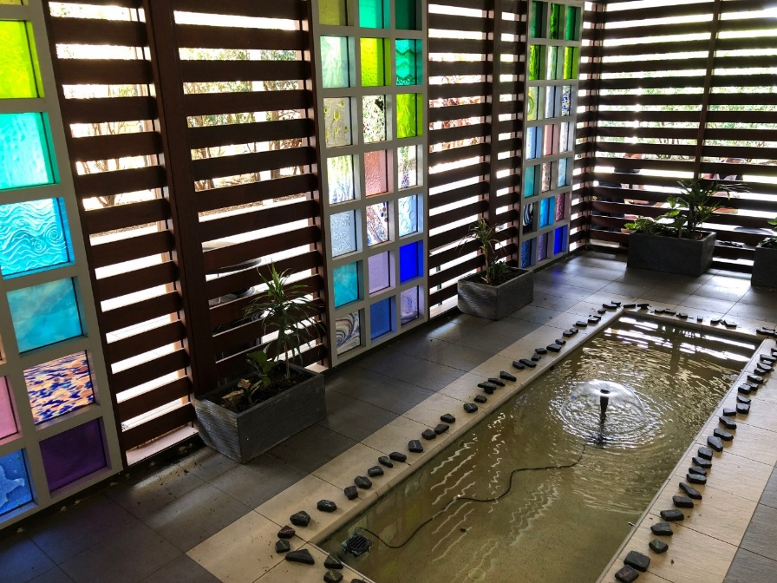
Catholic Social Teaching: Common Good, Dignity of the Human Person, Solidarity, Subsidiarity MAM Values: LOVE, HOPE, JUSTICE AND COMPASSION
Identify 2-3 examples of bringing the values to life in your work at MSM in 2018. Why have you chosen these examples?
What challenges you in living these values?

Slide 17
Catholic Social Teaching: Common Good, Dignity of the Human Person, Solidarity, Subsidiarity MAM Values: LOVE, HOPE, JUSTICE AND COMPASSION
Select a card that speaks to you about the opportunities to continue to ‘bring to life the values’ in 2019?
Why have you chosen this?
What could be a related goal for you/ your team?

Slide 18
Mission and Values: How do they inform and influence culture at MSM College?
What are the connections?
What has provoked your imagination and curiosity?
Where are the challenges?
How will you follow-up?
What are the opportunities?
What place of responsibility and influence is yours?
Notes:
Conclusion: go back to your sketch of the culture of MSM: going forward sketch your ideal culture as it relates to the Mission and Vison of the College.

