Slide 2
Mt St Michael’s College Leadership Team Workshop: By this everyone will know…..
30 April, 2018

Slide 3
Why of this story…..
The aim of the Contemporary Indicators Project,
is to develop a set of practical indicators which
define, identify and affirm a Catholic school
conducted in the tradition of Mary Aikenhead
and the Sisters of Charity and
under the stewardship of Mary Aikenhead Ministries.

Slide 4
The Contemporary Indicators Project seeks to:
identify the defining elements of a Catholic school conducted within the vision, mission and values of the Sisters of Charity and Mary Aikenhead Ministries.
develop a sense of identity for the education ministry that reflects and preserves the defining elements of a Catholic school and the heritage, tradition and charism of the Sisters of Charity !
encourage the ability to respond in creative and purposeful ways to future context.

Slide 5
The Contemporary Indicators Project seeks to
create cultures in the Colleges which are a vibrant, robust and dynamic expression of the vision, mission and values of the Sisters of Charity and Mary Aikenhead Ministries.
foster collaborative and cohesive relationships between the Colleges and other entities of the education ministry reflective of a national identity.
assist in the development of processes of discernment, validation and renewal which encourage the College’s pursuit of improvement as Catholic schools within the tradition of Mary Aikenhead and the Sisters of Charity and under the stewardship of Mary Aikenhead Ministries.

Slide 6
‘By this everyone will now…’ The journey and context….
Mary Aikenhead Education Advisory Council, 2013
Consultative and iterative process involving a series of meetings throughout 2014 & 2015 MAEAC, Principals, Boards, Leadership Teams
Draft document 2016
Promulgation 2017

Slide 7
How do we come to define and understand ourselves?
How do those in our community – and those outside of it – come to define and understand us?
What image do you think captures the identity of MSM?

Slide 8
What is the source of our identity?

Slide 9
The importance of story:
"...stories are important to people, politics, and education. Stories are how people make sense of themselves and their worlds. In a real sense, stories make people.”

Slide 10
Our story finds expression in our identity – the way we see ourselves and the way that others see us. This identity is transmitted through physical environment, symbols/icons, relationships, structures, priorities as well as what is hidden.

Slide 11
What story/stories are a critical part of the identity of Mt St Michael’s College?

Slide 12
There are three stories which help us to understand and enliven our identity:
Catholic nature and tradition of our school
Prophetic response of Mary Aikenhead and the Sisters of Charity to the Gospel
Dynamic response of this community to our context and conventions.

Slide 13
THE ENDURING STORY Jesus, his life, ministry and the values of the Gospel THE EXPRESSIVE STORY How the enduring story and these values are given expression in the prophetic response of Venerable Mary Aikenhead and the Congregation through their charism, ministry and tradition THE EVOLVING STORY How we today work with these legacies in an interpretive manner that carries our faith, spirituality, and tradition purposefully forward to meet the challenges revealed in the signs of the times

Slide 14
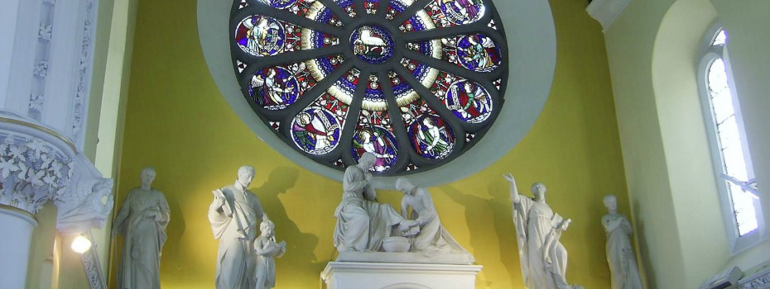
THE ENDURING STORY
Jesus, his life, ministry and the values of the Gospel as they find expression in the Catholic school.

Slide 15
How do we know that our College has a Catholic identity?
A Catholic school:
will be inspired by a vision that recognises the spiritual dimension of each person
emphasises the inalienable dignity of the human person
is a community of persons and a genuine community of faith
has a Catholic worldview which permeates the whole curriculum
is sustained by gospel witness.

Slide 16
THE EXPRESSIVE STORY How the enduring story and these values are given expression in the prophetic response of Venerable Mary Aikenhead and the Congregation through their charism, ministry and tradition.

Slide 17
‘Memory and the vision of possibility, through imagination create a future.’
Rev David Ranson

Slide 18
THE EVOLVING STORY
How we today work with these legacies in an interpretive manner that carries our faith, spirituality, and tradition purposefully forward to meet the challenges revealed in the signs of the times.

Slide 19
The Evolving story:
…reading the gospel in the context and signs of the times….

Slide 20
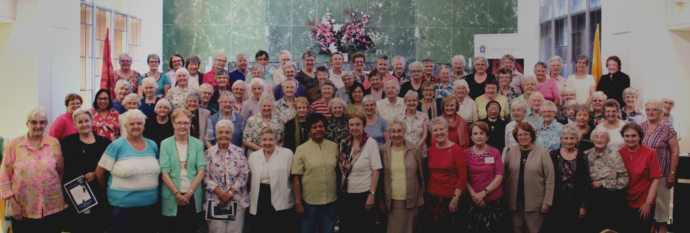

Slide 21
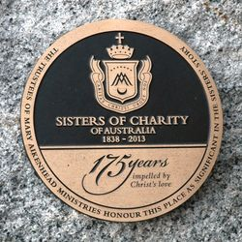
What are the ‘signs of the times’ for MSM?

Slide 22
By this everyone will know….
Guiding, foundational, working document with scope to contextualise in own setting.
Structure of the document:
Context MAM/MAE Strategic Intentions
Preamble, context of Mary Aikenhead Ministries: Enduring, Expressive and Evolving stories
Catholic Nature of MAM Schools, reference to Church documents
Overarching Statement: : ‘Love of Christ impels’, strong notion of Stewardship
Contemporary Indicators X 5. these are the cultural characteristics, they are inter related and underpinned by the MAM Values of Love, Justice, Compassion and Hope

Slide 23
By this everyone will know……
Enduring Story: Jesus, and his life, ministry and the values of the Gospel: Potential to consider scripture, reflect on the key messages of the life of Jesus as it speaks to you in your ministry today.
Expressive Story, how this story and these values are given expression in the prophetic response of Venerable Mary Aikenhead and the Sisters of Charity through their charism, ministry and tradition: potential to share, reflect upon values of Mary Aikenhead and the Sisters of Charity that are evidenced in your ministry today?
Evolving Story, how we work with these legacies in an interpretive manner that carries our faith, spirituality and tradition purposefully forward to meet the challenges revealed in the signs of the times: potential to consider the emerging story of your ministry, in the context of current stewardship, future opportunities, being a prophetic people.

Slide 24
‘By this everyone will know…’
Catholic colleges under the stewardship of Mary Aikenhead will be known through.. Cultural characteristics.
Catholic colleges under the stewardship of Mary Aikenhead Ministries may evidence this by…Evidential characteristics.
Enlivening the Mission: journey in growth, journey in collective formation, alignment of our organisation, continual prophetic responses to the signs of the times. About ‘bringing to each person the love tenderness and concern of Christ for those in need.’

Slide 25
By this everyone will know……MAEA contemporary indicators
The love of Christ impels us | A source of witness A call to action Experiencing the love of Christ in all structures, processes, programs, relationships and actions
Preferential option for the poor Social action and justice | Preferential option for the poor and vulnerable Rigorous and vigorous advocacy for justice Promoting opportunities for hope
Trust in Divine Providence A spirituality of possibility | Deep personal faith and a spirituality of action The immanence of God in our mission The presence of the Divine in each and all
Contemplatives in action Learning and teaching | Ignatian reflection and discernment Relationship between individual God and the world Contemplation and discernment leading to transformation
Called to be extensively useful Achievement and excellence | Educational outcomes that deliver high achievement Responsibility to contribute to the common good Commitment to service and social and cultural innovation for justice
Going to the margins Forward thinking and innovation | Cultures of restlessness Moving to need Creativity and imagination
Notes:
The Love of Christ impels us: the over-arching indicator . It speaks of a source to witness, a call to action and experiencing the love of Christ in all structures, processes, programs, relationships and actions.
Service of the poor, Social Action and justice: preferential option for the poor and vulnerable, advocacy for justice, promoting opportunities for hope.
Trust in Divide Providence, a spirituality of possibility: deep personal faith and a spirituality of action, the presence of the Divine in each and all, the immanence of God in our mission.
Contemplatives in action, learning and teaching: Ignatian reflection and discernment, relationships between individual, God and the world, contemplation and discernment leading to transformation.
Called to be extensively useful, achievement and excellence: educational outcomes that deliver high achievement, responsibility to contribute to the common good, commitment to service and social and cultural innovation for justice.
Going to the margins, forward thinking and innovation: cultures of restlessness, moving to need, creativity and imagination.

Slide 26
It is intended that ‘By this everyone will know’ will be used in schools in ways that are:
ASPIRATIONAL
Providing our schools with characteristics to aim for in their desire to further express their Catholic nature and Mary Aikenhead spirit.

Slide 27
It is intended that ‘By this everyone will know’ will be used in schools in ways that are:
INSPIRATIONAL
Encouraging our schools to develop ways to strengthen and renew their Catholic nature and Mary Aikenhead spirit.

Slide 28
It is intended that ‘By this everyone will know’ will be used in schools in ways that are:
TRANSFORMATIONAL
Emboldening our schools to renew their structures, processes and relationships in the light of their evolving understanding of what it means to be a school with an enduring and visible commitment to Catholic nature and Mary Aikenhead spirit for our times.

Slide 29
If we are to be ASPIRATIONAL and INSPIRATIONAL and truly TRANSFORMATIONAL this calls for us to be IMAGINATIVE

Slide 30
What are we being called to be as an expression of our mission in our Church?

Slide 31
What do we draw from our enduring and expressive stories that will inspire and craft our identity going into the future?

Slide 32
It is intended that ‘By this everyone will know’ will be used in schools in ways that are:
ASPIRATIONAL
Providing our schools with characteristics to aim for in their desire to further express their Catholic nature and Mary Aikenhead spirit.

Slide 33
How do we create an intentional community that is founded in our continuing narrative, but which also brings new life and possibility to us ?

Slide 34
‘By this everyone will know’ | What do we know? | Where can we be?
The love of Christ impels us A source of witness A call to action Experiencing the love of Christ in all structures, processes, programs, relationships and actions
Preferential option for the poor Social action and justice Preferential option for the poor and vulnerable Rigorous and vigorous advocacy for justice Promoting opportunities for hope
Trust in Divine Providence A spirituality of possibility Deep personal faith and a spirituality of action The immanence of God in our mission The presence of the Divine in each and all

Slide 35
‘By this everyone will know’ | What do we know? | Where can we be?
Contemplatives in action Learning and teaching Ignatian reflection and discernment Relationship between individual God and the world Contemplation and discernment leading to transformation
Called to be extensively useful Achievement and excellence Educational outcomes that deliver high achievement Responsibility to contribute to the common good Commitment to service and social and cultural innovation for justice
Going to the margins Forward thinking and innovation Cultures of restlessness Moving to need Creativity and imagination

Slide 36
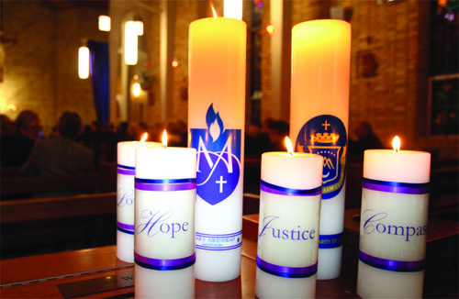
Where to now?......

Slide 37
In the context of MSM in 2018 and beyond..
How will you collaborate to enliven and embed this document in the life of MSM?
How will you define, measure and monitor your individual and collective outcomes in relation to ‘By this everyone will know…’

