Slide 2
Mt St Michael’s College Staff Day 24 January, 2019
‘ By this everyone will know…’
An exploration of what it is to be a Mary Aikenhead Ministries'’ College.

Slide 3
Aims and Purpose:
To provide a continuing space for formation in Mary Aikenhead Ministries
Familiarity with MAEA resource: ‘ By this everyone will know…’
Place this resource in the context of prior knowledge and experience
To provide a space to place MSM and self in the story, by engagement with this document
To provide a space to be affirmed and forward-looking

Slide 4
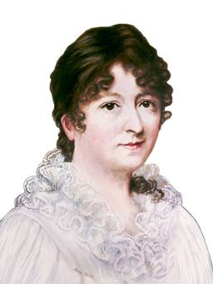
MSM Staff Day 18 January, 2017
Venerable Mary Aikenhead: life, choice s and legacy
Sisters of Charity: charism, ministries, Australian journey
Mary Aikenhead Ministries: 2009-today
Catholic Social Teaching: understanding the possibilities for MSM in 2017.
Venerable Mary Aikenhead: life, choice s and legacy
Sisters of Charity: charism, ministries, Australian journey
Mary Aikenhead Ministries: 2009-today
Catholic Social Teaching: understanding the possibilities for MSM in 2017.

Slide 5
“And no-one sews a patch of unshrunk cloth to an old coat; for then the patch tears away from the coat, and leaves a bigger hole. Neither do you put new wine into old wine-skins; if you do, the skins burst, and then the wine runs out and the skins are spoilt.” Mark 2:22
In the spirit of renewal and responding to the needs of the Church in the 21st century, the Sisters of Charity look towards the future with joy and hope. In considering a new sponsorship model, we have focused on the ministries, with respect for and celebration of the rich heritage of the works originally undertaken and developed by the Sisters of Charity. We trust that the newly chosen sponsorship model will further these ministries.
Extract from the Theological Statement

Slide 7
What is the source of our identity, our value system, benchmarks for our work?
How do we come to define and understand ourselves?
How do those in our community – and those outside of it – come to define and understand us?

Slide 8
Mary Aikenhead Education Advisory Council, 2013
Consultative and iterative process involving a series of meetings throughout 2014 & 2015 MAEAC, Principals, Boards, Leadership Teams
Draft document 2016
Promulgation 2017
Embedding in the fabric and journey of each college: 2018 onwards…..

Slide 9
By this Everyone will know…..

Slide 10
Guiding, foundational, working document with scope to contextualise in own setting.
Structure of the document:
Context MAM/MAE Strategic Intentions
Preamble, context of Mary Aikenhead Ministries: Enduring, Expressive and Evolving stories
Catholic Nature of MAM Schools, reference to Church documents
Overarching Statement: : ‘Love of Christ impels’, strong notion of Stewardship
Contemporary Indicators X 5. these are the cultural characteristics, they are inter related and underpinned by the MAM Values of Love, Justice, Compassion and Hope

Slide 11
Catholic colleges under the stewardship of Mary Aikenhead will be known through.. Cultural characteristics.
Catholic colleges under the stewardship of Mary Aikenhead Ministries may evidence this by…Evidential characteristics.
Enlivening the Mission: journey in growth, journey in collective formation, alignment of our organisation, continual prophetic responses to the signs of the times. About ‘bringing to each person the love tenderness and concern of Christ for those in need.’

Slide 12
THE ENDURING STORY Jesus, his life, ministry and the values of the Gospel THE EXPRESSIVE STORY How the enduring story and these values are given expression in the prophetic response of Venerable Mary Aikenhead and the Congregation through their charism, ministry and tradition THE EVOLVING STORY How we today work with these legacies in an interpretive manner that carries our faith, spirituality, and tradition purposefully forward to meet the challenges revealed in the signs of the times

Slide 13
The love of Christ impels us | A source of witness A call to action Experiencing the love of Christ in all structures, processes, programs, relationships and actions
Preferential option for the poor Social action and justice | Preferential option for the poor and vulnerable Rigorous and vigorous advocacy for justice Promoting opportunities for hope
Trust in Divine Providence A spirituality of possibility | Deep personal faith and a spirituality of action The immanence of God in our mission The presence of the Divine in each and all
Contemplatives in action Learning and teaching | Ignatian reflection and discernment Relationship between individual God and the world Contemplation and discernment leading to transformation
Called to be extensively useful Achievement and excellence | Educational outcomes that deliver high achievement Responsibility to contribute to the common good Commitment to service and social and cultural innovation for justice
Going to the margins Forward thinking and innovation | Cultures of restlessness Moving to need Creativity and imagination

Slide 14
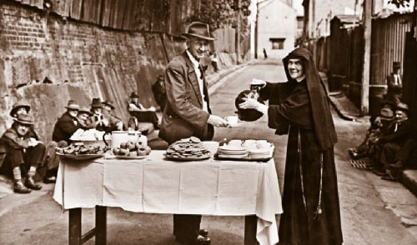
‘ By this everyone will know…’

Slide 15
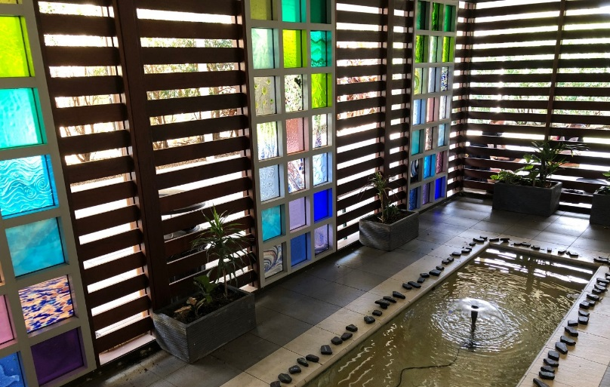
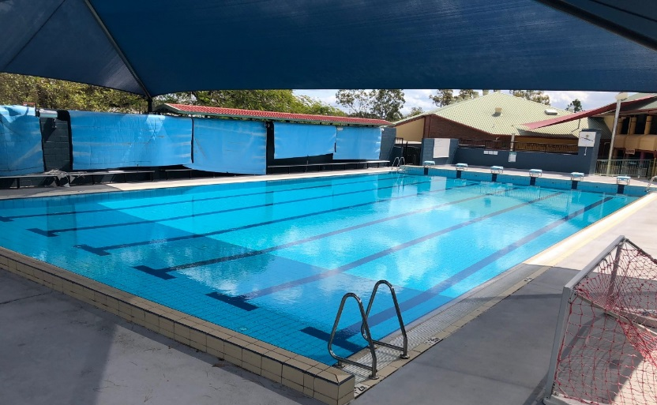
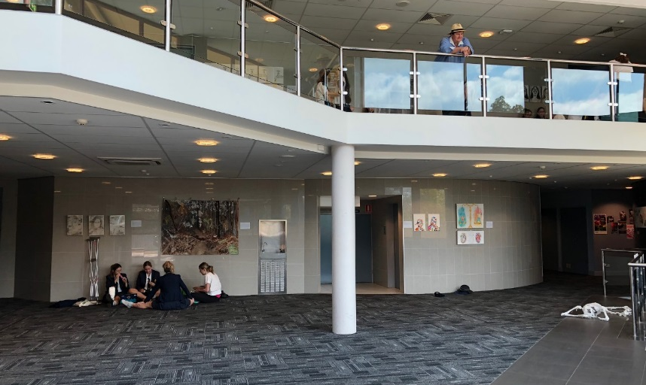
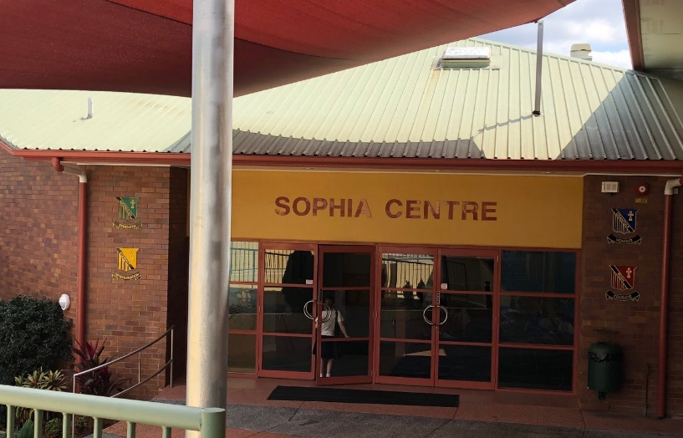
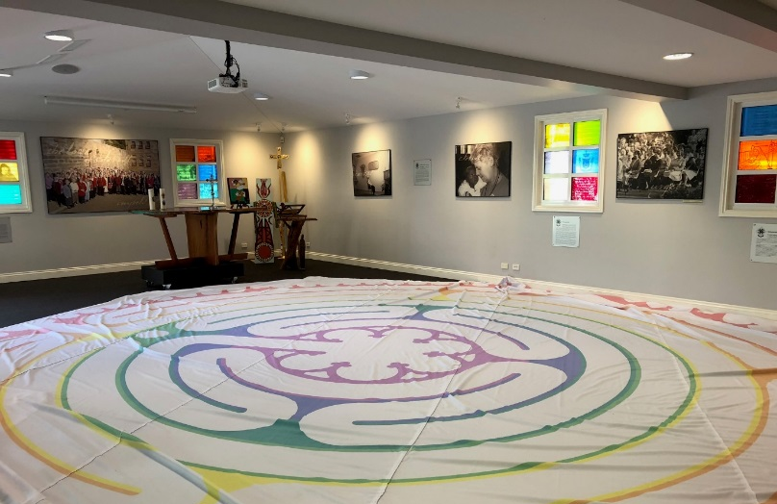
‘ By this everyone will know…’
How do we define and understand ourselves?
Notes:
What are our/MSM connections to the MAEA Contemporary Indicators?

Slide 16
In the context of MSM in 2019 and beyond..
How will you collaborate to enliven and embed this document in the life of MSM?
How will you define, measure and monitor your collective outcomes in relation to ‘By this everyone will know…’
Notes:
Invitation to have a conversation about one of the indicators. MMK to go through each one, then break for discussion.

Slide 17
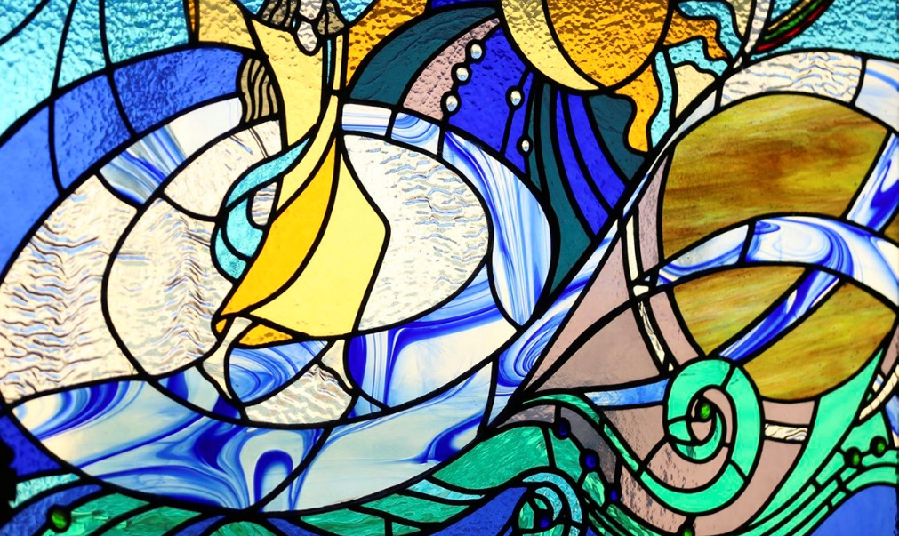
The Love of Christ Impels Us
This is the overarching indicator.
As you sit with what ‘the Love of Christ Impels us’ you are invited to think about Mary Aikenhead, the Sisters of Charity, Mt St Michaels’ College and the shared heritage and gifts of Mary Aikenhead Ministries.
How will you, as MSM Staff Member endorse and promote the spirit of this indicator at MSM in 2019?

Slide 18
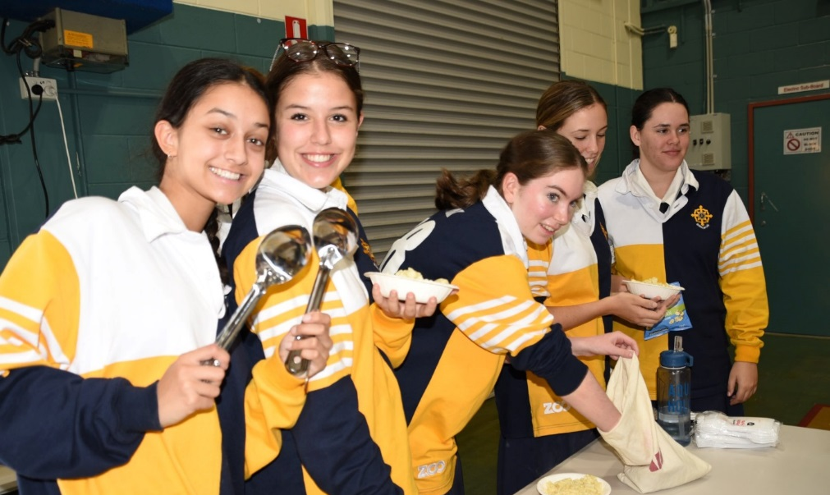
Preferential option for the poor: social action and justice
How do you understand this indicator?
What are the clarifying questions that will help promote and embed understanding and experience of this indicator at MSM in 2019?

Slide 19
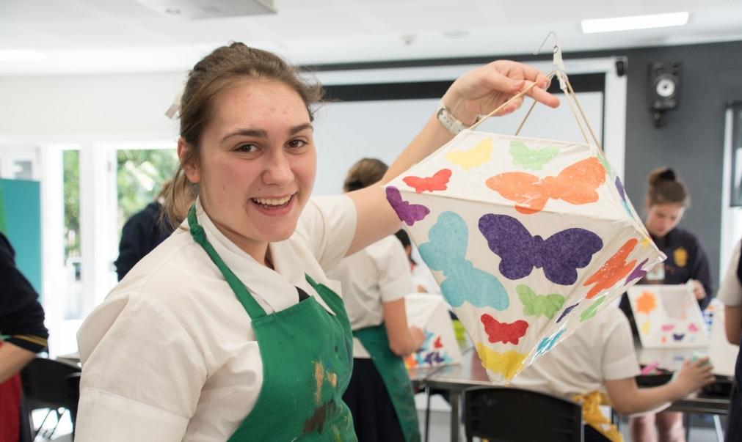
Trust in Divine Providence: a spirituality of possibility
How do you understand this indicator?
What are the clarifying questions that will help promote and embed understanding and experience of this indicator at MSM in 2019?

Slide 20
Contemplatives in Action: learning and teaching
How do you understand this indicator?
What are the clarifying questions that will help promote and embed understanding and experience of this indicator at MSM in 2019?

Slide 21
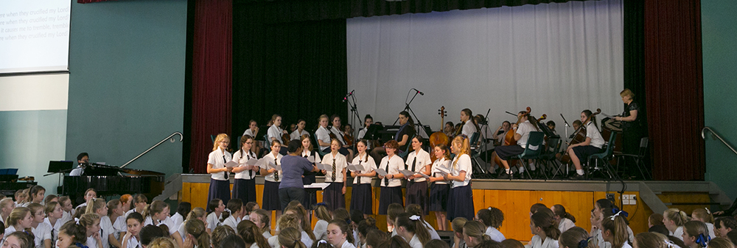
Called to be extensively useful: achievement and excellence
How do you understand this indicator?
What are the clarifying questions that will help promote and embed understanding and experience of this indicator at MSM in 2019?

Slide 22
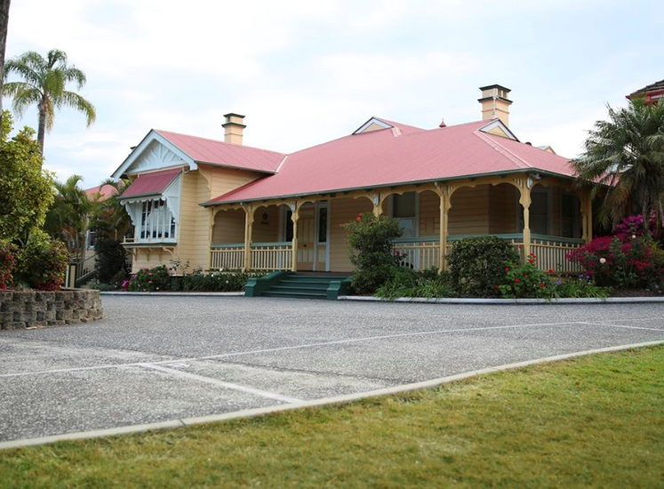
Going to the margins: forward thinking and innovation
How do you understand this indicator?
What are the clarifying questions that will help promote and embed understanding and experience of this indicator at MSM in 2019?

Slide 23
Extract from MAEA Mission Formation Policy
Formation for Mission is an ongoing and life-giving journey for each College. Trustee events and foundational documents support this ongoing journey. ‘By this everyone will know...’, the contemporary indicators for Mary Aikenhead Ministries’ colleges is considered central to the development and delivery of formation programs and experiences. It is the expectation of this policy that the pillars of the Enduring, Expressive and Evolving stories will inform and guide mission and formation.
Notes:
Going forward, this will be part of formation at MSM. MAEA seeking to embed this resource in the life of the college.

Slide 24
What is the source of our identity, our value system, benchmarks for our work?
How do we come to define and understand ourselves?
How do those in our community – and those outside of it – come to define and understand us?
Notes:
Invitation to be part of the story, understand the heritage, grounded in the life and ministry of Jesus. Now as part of the evolving story, how do we/I contribute to and influence to story going forward?

