Slide 1
The Love of Christ Impels Us
What are the clarifying questions that will help promote and embed your understanding of this indicator for you as Board Director at St Columba’s College?

Slide 2
Preferential option for the poor: social action and justice
Are there further clarifying questions that will help your understanding of this indicator for you as Board Director at St Columba’s College?
Is there any aspect of this indicator that informs part of the Board 2019 priorities?
What?

Slide 3
Trust in Divine Providence: A spirituality of possibility
Are there further questions that will help your understanding of this indicator for you as Board Director at St Columba’s College?
Is there any aspect of this indicator that is part of the Board 2019 priorities?
What?

Slide 4
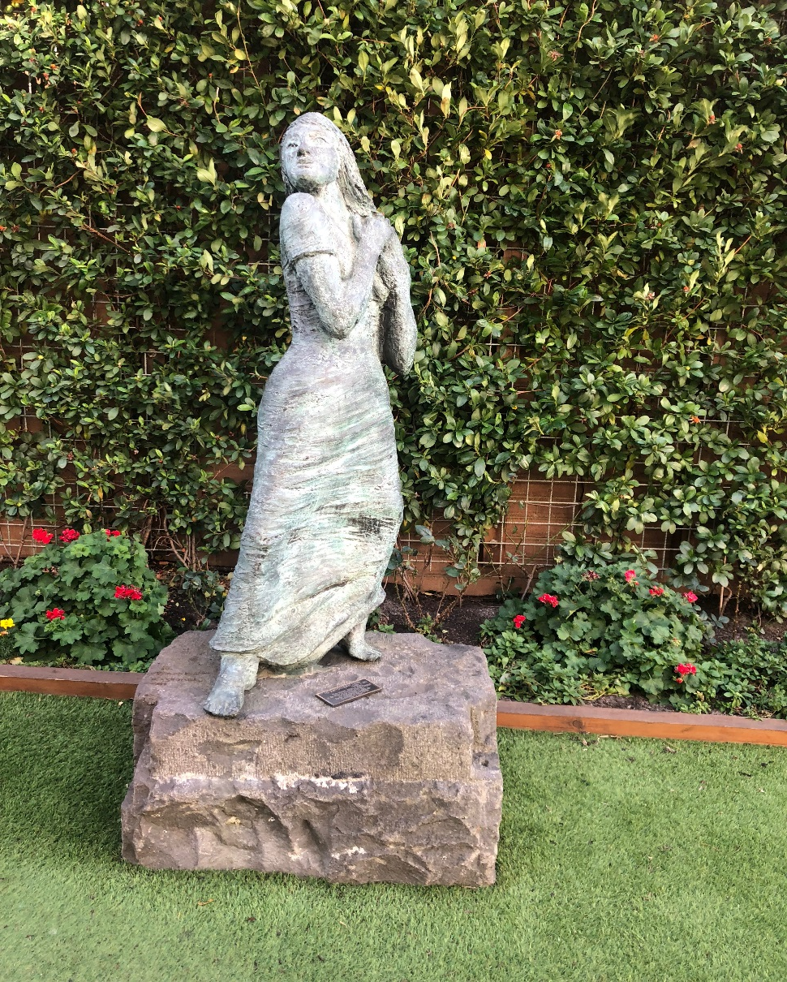
Contemplatives in action: learning and teaching
Are there further questions that will help your understanding of this indicator for you as Board Director at St Columba’s College?
Is there any aspect of this indicator that is part of the Board 2019 priorities?
What?

Slide 5
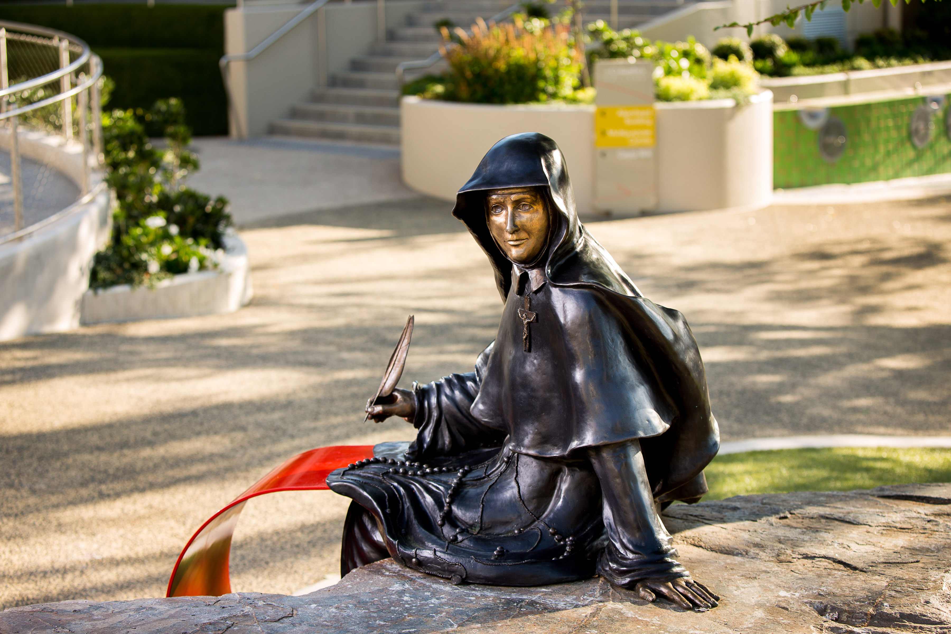
Called to be extensively useful: achievement and excellence.
Are there further questions that will help your understanding of this indicator for you as Board Director at St Columba’s College?
Is there any aspect of this indicator that is part of the Board 2019 priorities?
What?

Slide 6
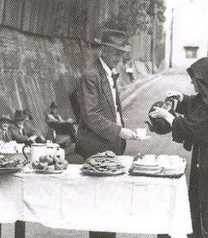
Going to the margins: forward thinking and innovation
Are there further questions that will help your understanding of this indicator for you as Board Director at St Columba’s College?
Is there any aspect of this indicator that is part of the Board 2019 priorities?
What?

Slide 7
By this everyone will know……MAEA contemporary indicators
The love of Christ impels us | A source of witness A call to action Experiencing the love of Christ in all structures, processes, programs, relationships and actions
Preferential option for the poor Social action and justice | Preferential option for the poor and vulnerable Rigorous and vigorous advocacy for justice Promoting opportunities for hope
Trust in Divine Providence A spirituality of possibility | Deep personal faith and a spirituality of action The immanence of God in our mission The presence of the Divine in each and all
Contemplatives in action Learning and teaching | Ignatian reflection and discernment Relationship between individual God and the world Contemplation and discernment leading to transformation
Called to be extensively useful Achievement and excellence | Educational outcomes that deliver high achievement Responsibility to contribute to the common good Commitment to service and social and cultural innovation for justice
Going to the margins Forward thinking and innovation | Cultures of restlessness Moving to need Creativity and imagination

