Slide 1



Slide 2
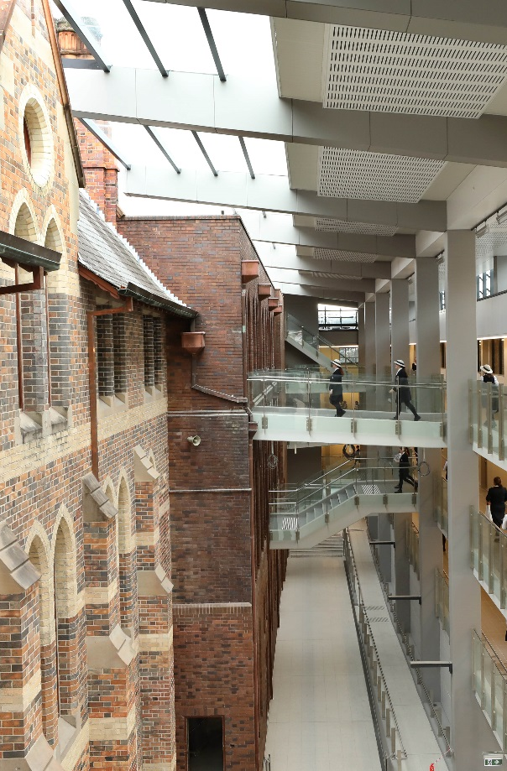
Aims and Purpose:
To provide a continuing space for formation in Mary Aikenhead Ministries
Familiarity with MAEA resource: ‘ By this everyone will know…’
To provide a space to place SVC and self in the story, by engagement with this document

Slide 3

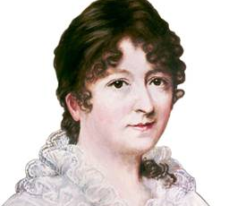
Venerable Mary Aikenhead: life, choices and legacy
Sisters of Charity: charism, ministries, Australian journey
Mary Aikenhead Ministries: 2009-today
St Vincent’s College as part of MAM/MAEA

Slide 4
“And no-one sews a patch of unshrunk cloth to an old coat; for then the patch tears away from the coat, and leaves a bigger hole. Neither do you put new wine into old wine-skins; if you do, the skins burst, and then the wine runs out and the skins are spoilt.” Mark 2:22
In the spirit of renewal and responding to the needs of the Church in the 21st century, the Sisters of Charity look towards the future with joy and hope. In considering a new sponsorship model, we have focused on the ministries, with respect for and celebration of the rich heritage of the works originally undertaken and developed by the Sisters of Charity. We trust that the newly chosen sponsorship model will further these ministries.
Extract from the Theological Statement

Slide 6
By this Everyone will know…..
Notes:
What is the source of our identity, our value system, benchmarks for our work. How do those in our community – and those outside of it – come to define and understand us?
What is it, what it is intended to be. Inspirational, aspirational( challenge) transformational. Embedded in life, relationships, programs, events, decisions, policies of the college going forward.
It is about identity, values system, and benchmarks into the future.
Formation Programs: begin the talk, share the language. Recognition by participants of the connections/threads/ links around the ‘big picture mission & vision. Be in the interpretative space and then move to contextualise in own college

Slide 7
By this Everyone will know…..
Mary Aikenhead Education Advisory Council, 2013
Consultative and iterative process involving a series of meetings throughout 2014 & 2015 MAEAC, Principals, Boards, Leadership Teams
Draft document 2016
Promulgation 2017
Embedding in the fabric and journey of each college: 2018 onwards…..

Slide 8
THE ENDURING STORY
Jesus, his life, ministry and the values of the Gospel
THE EXPRESSIVE STORY
How the enduring story and these values are given expression in the prophetic response of Venerable Mary Aikenhead and the Congregation through their charism, ministry and tradition
THE EVOLVING STORY
How we today work with these legacies in an interpretive manner that carries our faith, spirituality, and tradition purposefully forward to meet the challenges revealed in the signs of the times

Slide 9
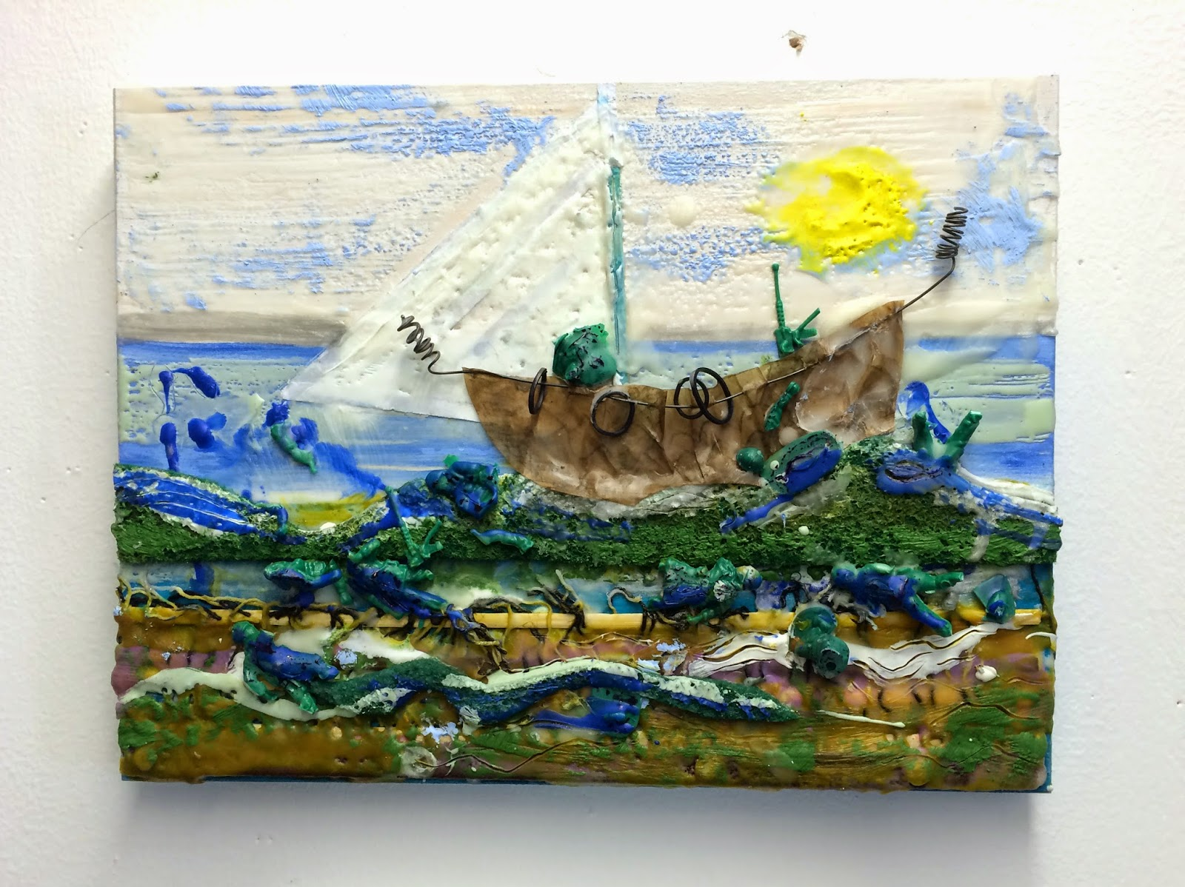

Slide 10
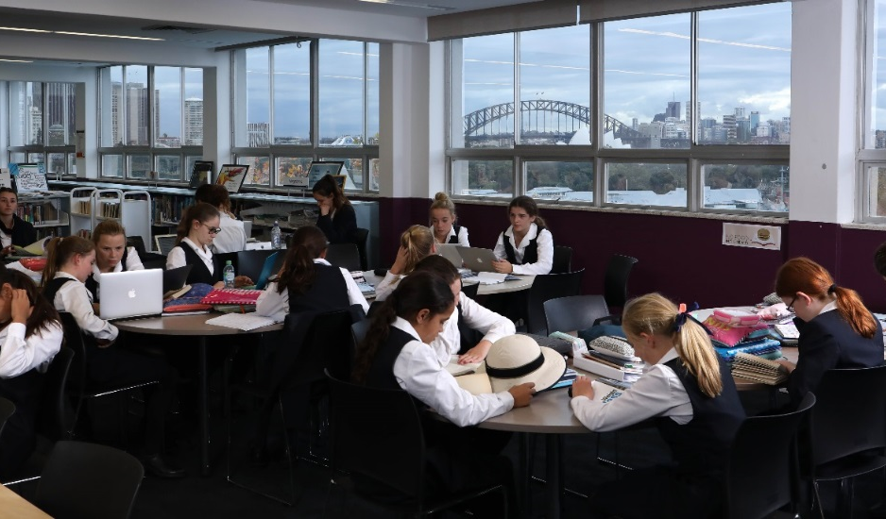
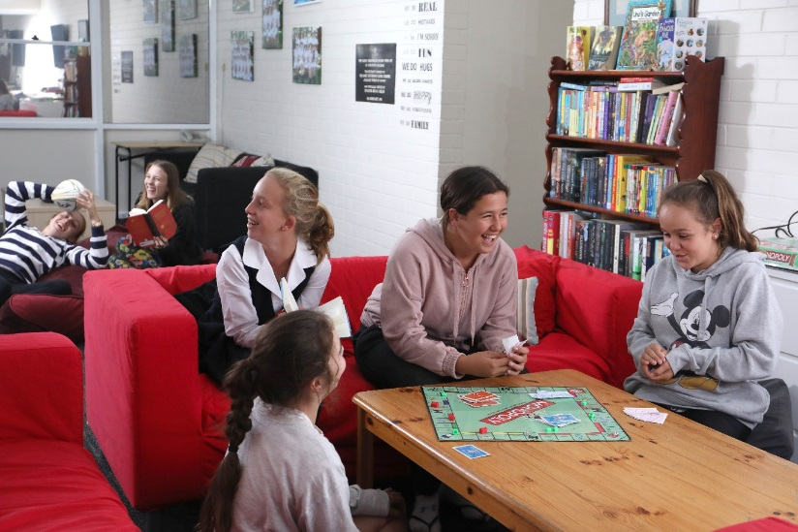
Catholic colleges under the stewardship of Mary Aikenhead will be known through.. Cultural characteristics.
Catholic colleges under the stewardship of Mary Aikenhead Ministries may evidence this by…Evidential characteristics.
Enlivening the Mission: journey in growth, journey in collective formation, alignment of our organisation, continual prophetic responses to the signs of the times. About ‘bringing to each person the love tenderness and concern of Christ for those in need.’
Notes:
Two important aspects here are the cultural characteristics, noted strongly in conversation by formation program participants.
evidential characteristics: how do we know? Experience? Understand? Measure? Embed?

Slide 11

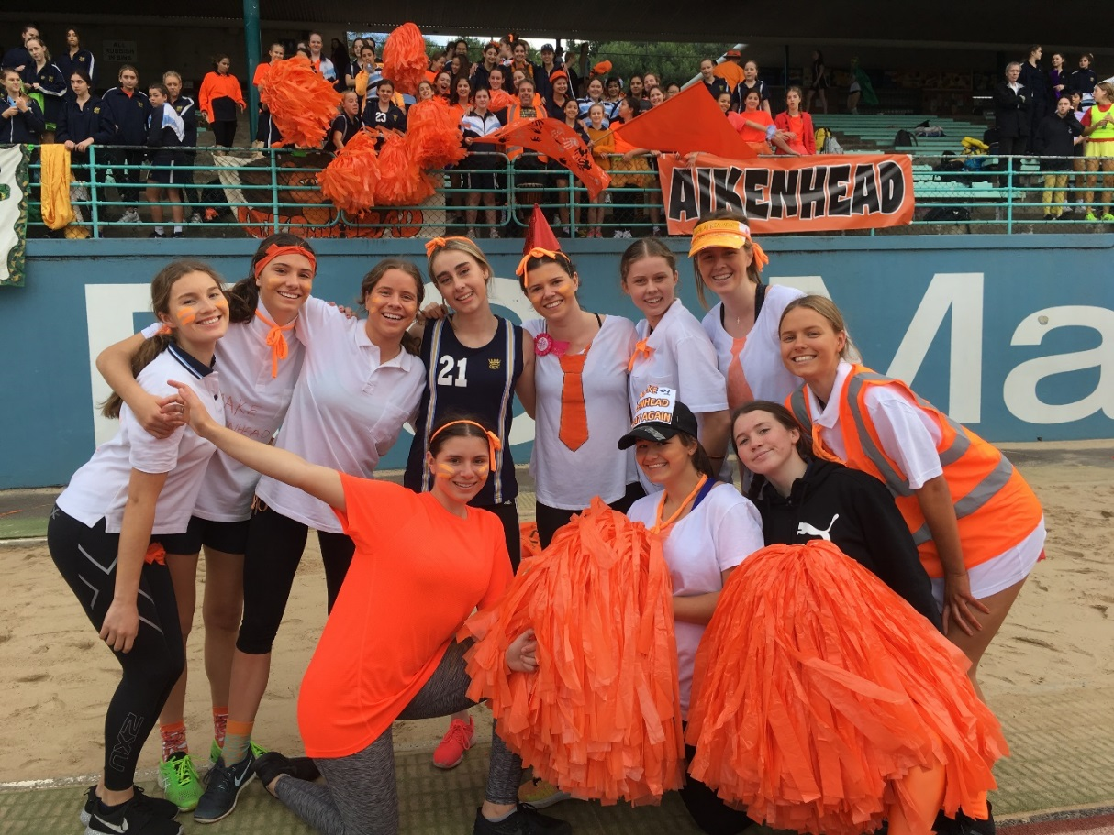
Guiding, foundational, working document with scope to contextualise in own setting.
Structure of the document:
Context MAM/MAE Strategic Intentions
Preamble, context of Mary Aikenhead Ministries: Enduring, Expressive and Evolving stories
Catholic Nature of MAM Schools, reference to Church documents
Overarching Statement: : ‘Love of Christ impels’, strong notion of Stewardship
Contemporary Indicators X 5. these are the cultural characteristics, they are interrelated and underpinned by the MAM Values of Love, Justice, Compassion and Hope
Notes:
Whilst the document is about culture, heritage and higher order concepts, it is important to understand the structure. To enable you to access and work with it.
Practical detail.
Intention overtime that it is an embedded document in the life of each college.

Slide 12
The love of Christ impels us | A source of witness A call to action Experiencing the love of Christ in all structures, processes, programs, relationships and actions
Preferential option for the poor Social action and justice | Preferential option for the poor and vulnerable Rigorous and vigorous advocacy for justice Promoting opportunities for hope
Trust in Divine Providence A spirituality of possibility | Deep personal faith and a spirituality of action The immanence of God in our mission The presence of the Divine in each and all
Contemplatives in action Learning and teaching | Ignatian reflection and discernment Relationship between individual God and the world Contemplation and discernment leading to transformation
Called to be extensively useful Achievement and excellence | Educational outcomes that deliver high achievement Responsibility to contribute to the common good Commitment to service and social and cultural innovation for justice
Going to the margins Forward thinking and innovation | Cultures of restlessness Moving to need Creativity and imagination
Notes:
The Love of Christ impels us: the over-arching indicator

Slide 13
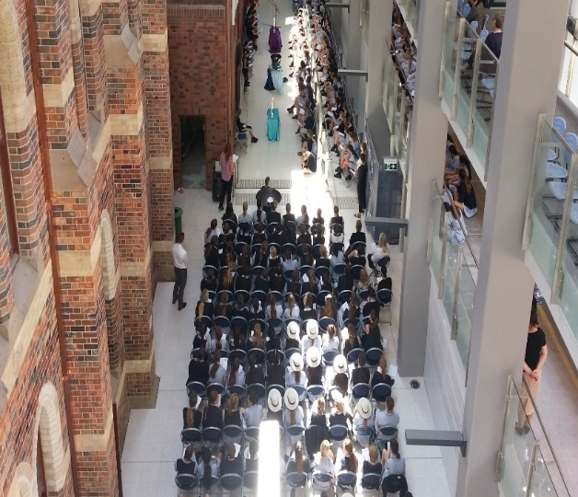
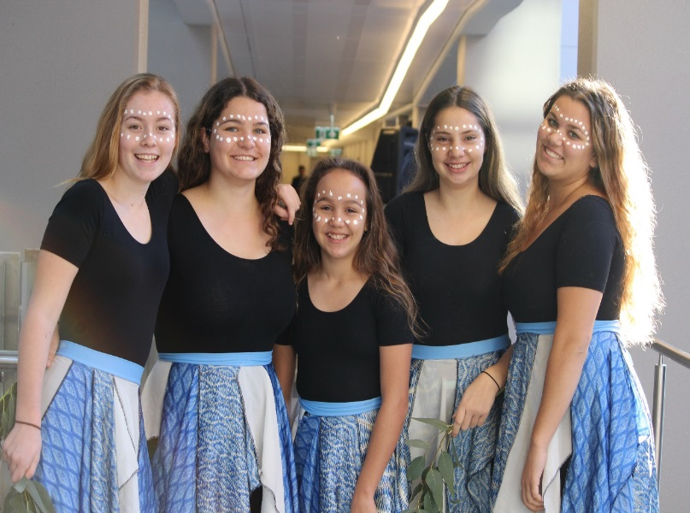
‘ By this everyone will know…’
How do we define and understand ourselves?
Notes:
What are our SCC connections to the MAEA Contemporary Indicators

Slide 14
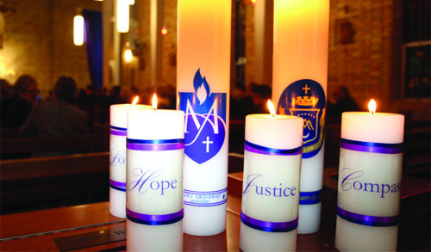
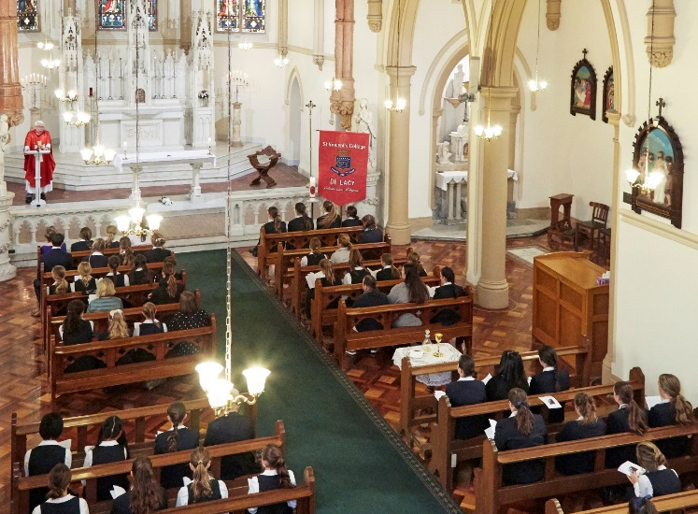
The Love of Christ Impels Us
This is the overarching indicator.
As you sit with what ‘ the Love of Christ Impels us’ you are invited to think about Mary Aikenhead, the Sisters of Charity, St Vincent's College and the shared heritage and gifts of Mary Aikenhead Ministries.
How will you, as SVC Staff Member endorse and promote the spirit of this indicator at SVC?

Slide 15
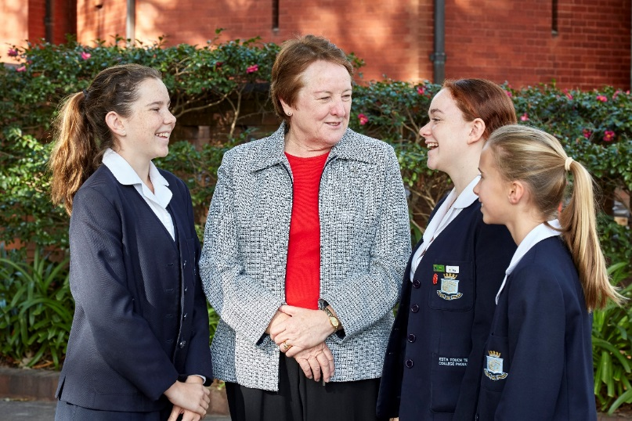
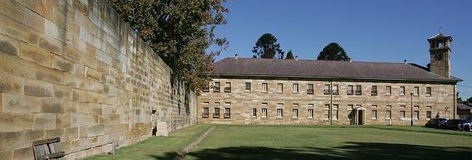
Preferential option for the poor: social action and justice
How do you understand this indicator?
What are the clarifying questions that will help promote and embed understanding of this indicator at SVC?

Slide 16
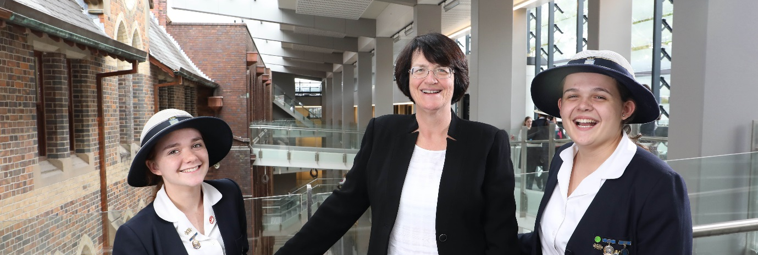
Trust in Divine Providence a spirituality of possibility
How do you understand this indicator?
What are the clarifying questions that will help promote and embed understanding of this indicator at SVC?

Slide 17
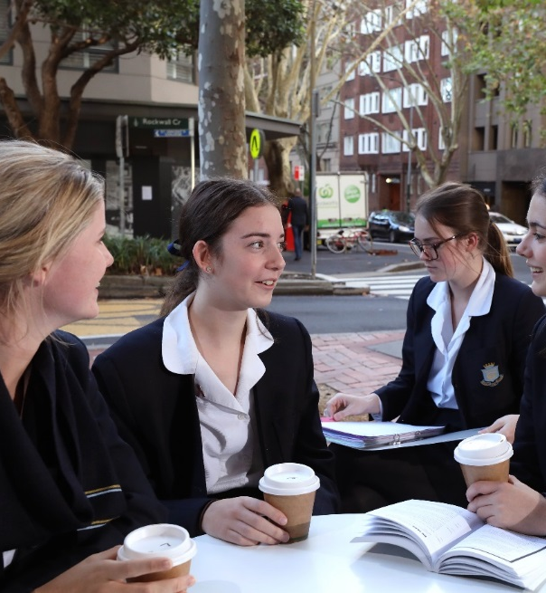
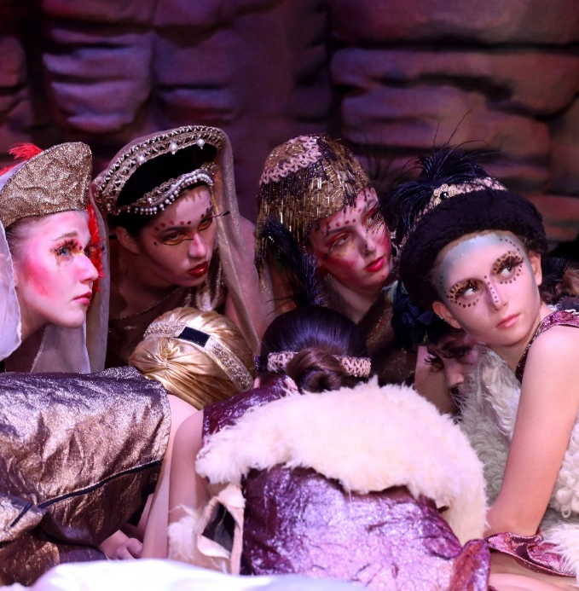
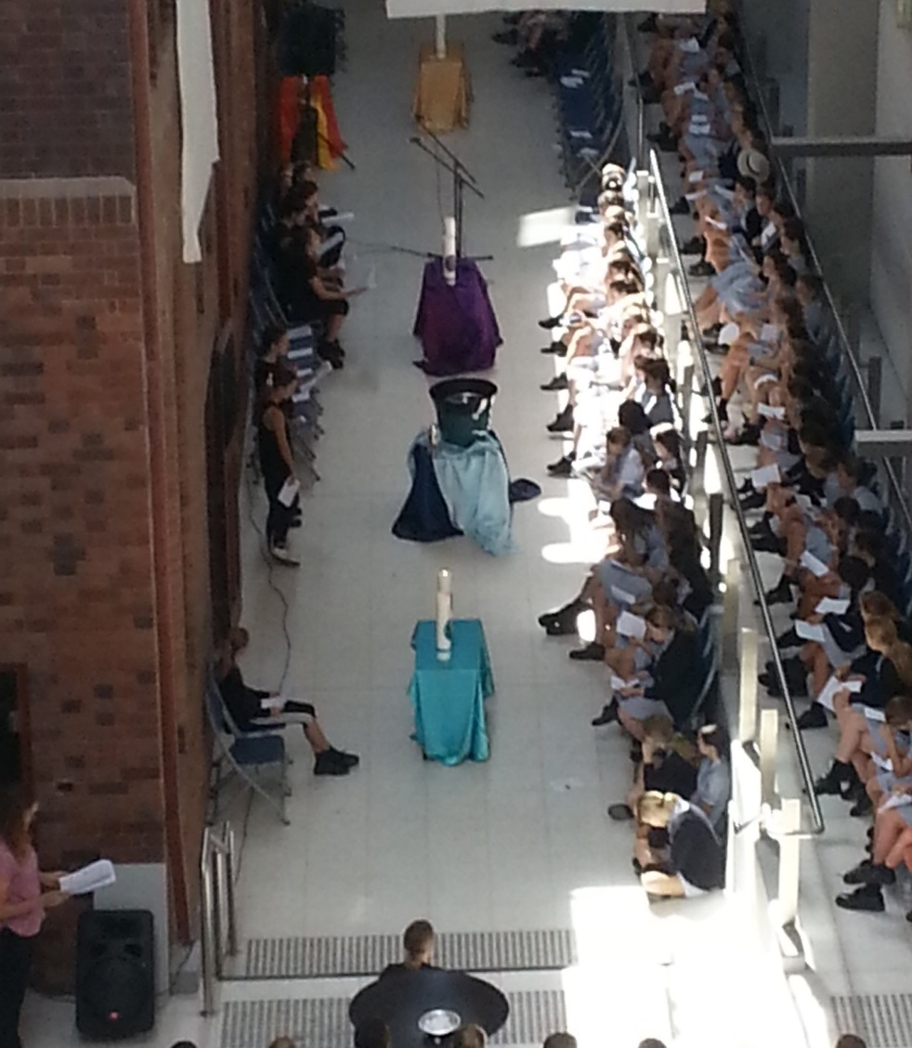
Contemplatives in Action: learning and teaching
How do you understand this indicator?
What are the clarifying questions that will help promote and embed understanding of this indicator at SVC ?

Slide 18
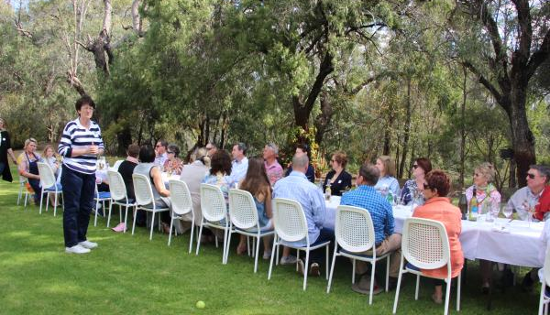
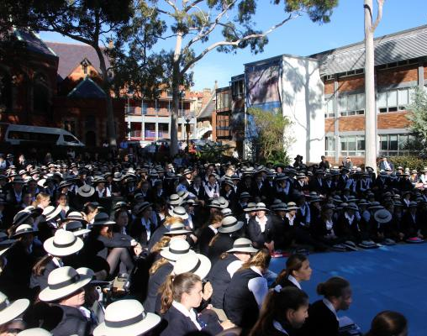
Called to be extensively useful: achievement and excellence
How do you understand this indicator?
What are the clarifying questions that will help promote and embed understanding of this indicator at SVC?

Slide 19

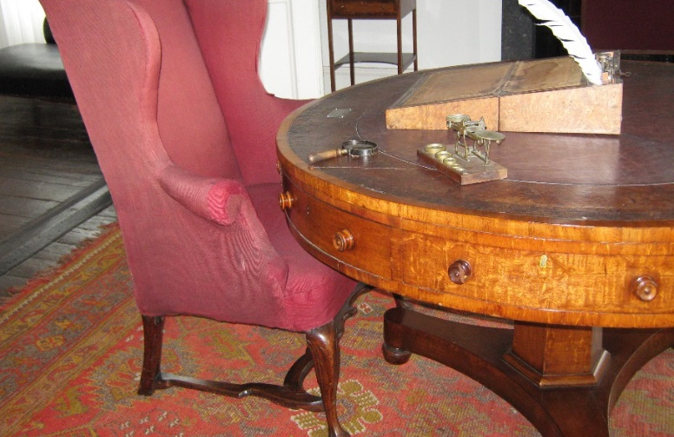
Going to the margins: forward thinking and innovation
How do you understand this indicator?
What are the clarifying questions that will help promote and embed understanding of this indicator at SVC?

Slide 20
In the context of St Vincent’s College in 2019 and beyond..
How will you collaborate to enliven and embed this document in the life of SVC ?
How will you define, measure and monitor your collective outcomes in relation to ‘By this everyone will know…’

Slide 21
Extract from MAEA Mission Formation Policy
Formation for Mission is an ongoing and life-giving journey for each College. Trustee events and foundational documents support this ongoing journey. ‘By this everyone will know...’, the contemporary indicators for Mary Aikenhead Ministries’ colleges is considered central to the development and delivery of formation programs and experiences. It is the expectation of this policy that the pillars of the Enduring, Expressive and Evolving stories will inform and guide mission and formation.

Slide 22
What is the source of our identity, our value system, benchmarks for our work?
As a Mary Aikenhead Ministries’ College how do those in our community – and those outside of it – come to define and understand us?
…Love Hope Justice Compassion Love Hope Justice Compassion Love Hope Justice Compassion Love Hope Justice Compassion Love Hope Justice Compassion Love Hope Justice Compassion Love Hope Justice Compassion Love Hope Justice Compassion Love Hope Justice Compassion Love Hope Justice Compassion Love Hope Justice Compassion Love Hope Justice Compassion Love Hope Justice Compassion Love Hope Justice Compassion Love Hope Justice Compassion Love Hope Justice Compassion…

Slide 23
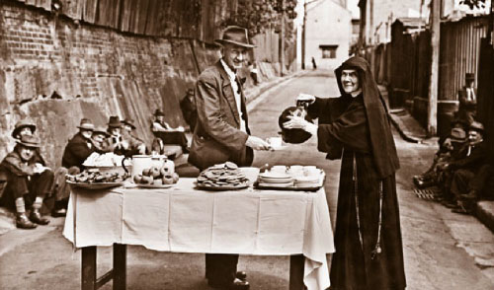
By this everyone will know…

Slide 24
Going Forward….
“ Our Congregation’s spirit and our inheritance is the gospel privilege of serving others, especially the poor. Our story is one of innovation, courage and conviction. It is our hope that this will continue. We are confident that through Mary Aikenhead Ministries, the spirit of service will flourish in new and progressive ways, always alive to the spirit of the times.”
Sr Elizabeth Dodds rsc, Congregational Leader at the time of MAM establishment.
“ We cannot live in the past, each age has its own challenges, we cannot continue to do things the ways that they were done; the true gifts for us are the opportunities as presented in the current time frame. It is amazing to think that the first five Sisters of Charity came to Australia with practically nothing, trusting in the providence and will of God.
The whole of the Catholic society has changed, past life revolved around Church, School and Parish.
Today we are touched by and open to many other influences, educate for now and the future – go forth as apostles of Christ, responding to the times.”
Sr Moira O’Sullivan rsc, April 2012

